Slide 1


SAP UI5 & FIORI with OData TRAINING
Anubhav Oberoy
Day – 16

Slide 2

Agenda – Day 16
Understanding How to deliver Fiori Apps
Deploying the App to ABAP Enviornment
Introduciton to Fiori Launchpad
Why we need a Launchpad
How to Access Launchpad
Basic Terms related to Launchpad
Relation between Front-End Components

Slide 3
Delivering Fiori Apps
Currently the Application we have developed is in our local system (VS Code or BAS). Now we want this app to be accessible by other people in our company, to do that we have to deploy this application to our ABAP environment or cloud platform where it can be accessed by others.
BAS/VS Code
GitHub
Development Team
destination
SCC
DEV
QLT
PROD
BSP App
BSP App
BSP App

Slide 4







Delivering Fiori Apps
2
ui5 build
Development Environment
(BAS, VSCode, etc.)
1
git push
dist
GitHub Repository
3
npm run deploy-config
Developer
deployment configuration
End Users
4
npm run deploy
ABAP Repository
PROD (P)
DEV
Quality(Q)
Transport Request
Transport Request
Admin
Launchpad and Launchpad Designer

Slide 5
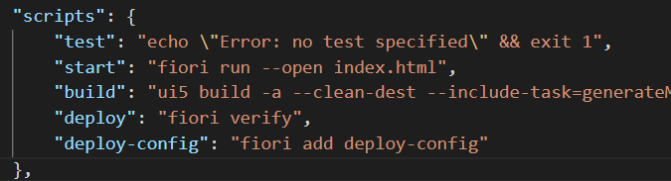
Adding deployment Configuration to App
Steps to configure the Application to deploy the Application on ABAP Environment.
Open the terminal in BAS or VS Code and go to your project folder.
Open terminal in you project folder.
Write command ui5 build or npm run build and press enter to build your project it will create a dist folder.
Now write command npx fiori add deploy-config to configure the project for deployment.
Select a target ABAP system … http://103.207.171.202 in your case your hostname will come in this step.
Enter the ABAP system client number …
Enter a username …
Enter a password …
Enter an application name …
Enter a description for the application …
Enter a package for the deployed application … $TMP
Now to deploy the application to the ABAP repository we use the command npm run deploy.

Slide 6
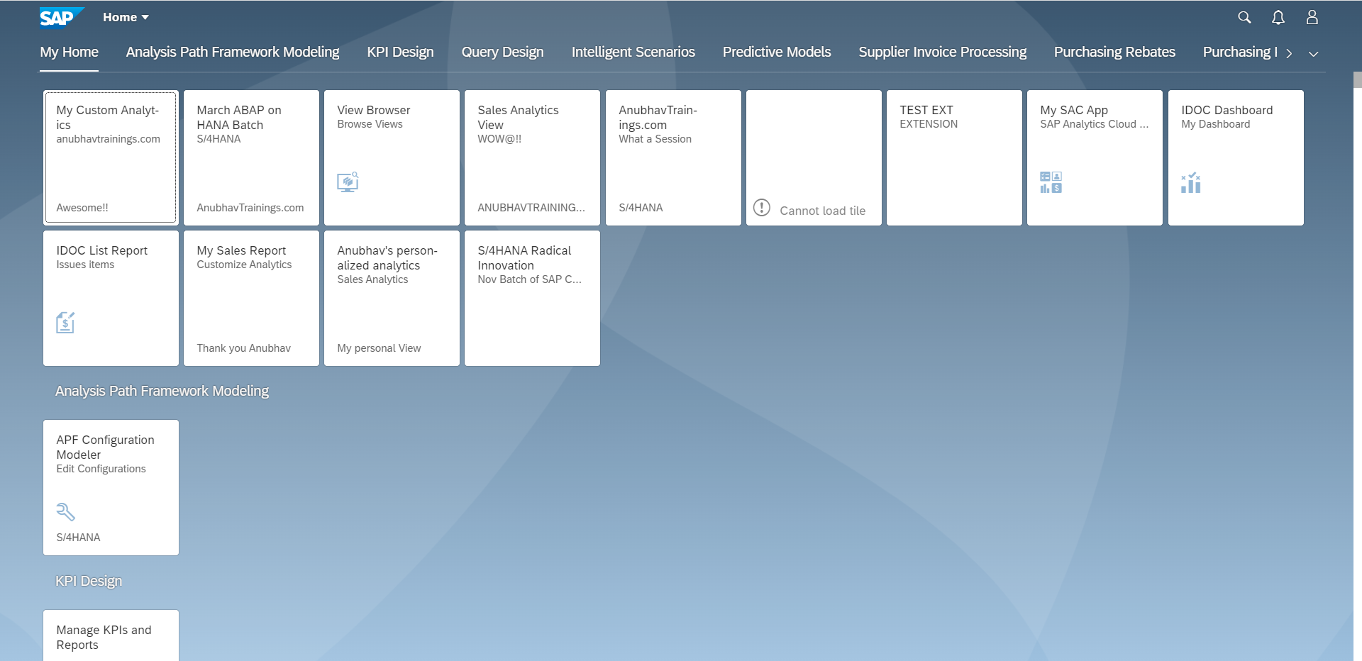
Fiori Launchpad
SAP Fiori Launchpad is a single access point for all the Applications in S/4HANA. Is available fiori frontend server once Fiori is installed in your SAP System.
The SAP Fiori launchpad is a shell that hosts SAP Fiori apps, and provides the apps with services such as navigation, personalization, embedded support, and application configuration.
The launchpad is the entry point to SAP Fiori apps on mobile and desktop devices. The launchpad displays a home page with tiles.
Each tile represents a business application that the user can launch. Tiles can also display live status indicators, such as the number of open tasks.
The launchpad is role-based. In other words, the user’s role determines which app tiles are shown.
Launchpad comes with Launchpad Designer (LPD), which allows developer/consultant to configure access to the apps as a Tile.
The TCode to access:
Launchpad: /N/UI2/FLP
Launchpad Designer: /n/UI2/FLPD_CONF

Slide 7
Why we require Launchpad
Just imagine, if my co. have developed 500 Apps in last Quarter, These 500 apps have got 500 URLs to access the app. As a end user, you would face below challenges
Finding URL for each app is a challenge
Making sure that you are right person to access app – Security
Also you should only be able to see apps which you are allowed to access
SAP Portal is now deprecated, what options do we have to access all functionality of ERP
Type of Fiori App Implementation
There are two types of Fiori App Implementations: Standard Apps and Customized Apps.
Standard Applications
Customized Apps
Implementation of those business apps, which are released by SAP
These are categorized as Transnational, Fact-sheets and Analytical apps etc.
As per business requirement, a complete custom fiori app can be implemented.
Customized App is been hosted on SAP-Fiori server (front-end system).
It integrates with SAP or Non-SAP system.

Slide 8
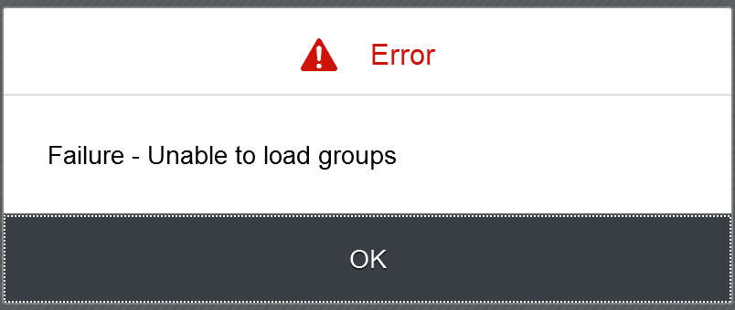
Fiori Launchpad Access
The service which is used by Launchpad to run
/UI2/INTEROP – This service controls navigation from tile to the Application
/UI2/PAGE_BUILDER_PERS – Launchpad personalization, Used to load all the tiles, groups of users, controls the loading of launchpad content for our users.
Trouble shooting:
The service is not even registered
The service is not even activate
You may not have authorization to access this service.

Slide 9
Basic Terms related to the Launchpad
Catalog – A Collection of all the Tiles, Each tile represent precisely one Application. We create catalog to package all tiles together according to team, functional area, application component, functionality, area of responsibility…
Tile – a square box which provides entry point for an app, it consists of 2 parts,
Tile Properties – title, subtitle, icon, ..
Intent - Semantic Object + Action
Semantic Object – The business object which is involved in the activity. Area of interest. E.g. SalesOrder, PurchaseOrder, OutboundDelivery, Customer, Vendor, Sales,..
Action – Define the purpose of our Fiori Application. Indicative of the Activity which we want to perform on Business object. E.g. Create, Change, Manage, Track, Maintain, Execute, Analyze
Intent ➔ SalesOrder-manage, OutboundDelivery-track
Note: Every application in entire system has unique intent.
3. Target Mapping – Maps the intent with the actual Fiori App, WeBGUI, Tcode, Webdynpro App.
4. Group – Is used to group tiles logically from business point of view, We never create tiles in group. We reference tiles in the group from catalog.
5. Role – A user will be granted a role and inside the role we will have the catalog and the group.
intent
Tile
Tile 1
Fiori App
Tile
Tile 2
Target Mapping

Slide 10
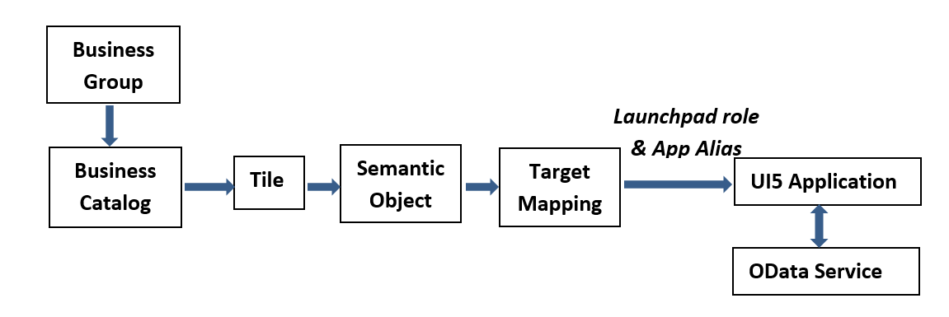
Relationship between Front-End Components

Slide 11

End of Day 16

Slide 12

Questions

Slide 13

Anubhav Oberoy

Slide 14


We’re committed to empower you to be
Most Desirable Resource
through powerful training solutions.
We build the workforce of the future.
250+
Corporate Clients
30,000+
Learners Trained
25000+
Learners Placed
FREE WEBINARS
Sign up for free webinars with industry experts every fortnight!
Enroll Now!
Contact us today!
https://anubhavtrainings.com/

Slide 15




More from AnubhavTrainings.com

Slide 16
Title
Content

